Slide 1
Predicting in vivo Toxicity: Beyond Modeling?
Russ Naven
November 20th 2015

Slide 2

Confidence in Ability to Predict Toxicity
Aromatic amine mutagenicity model
Modeling repeat dose toxicity
Non-genotoxic carcinogencity
External validation
Future
Confidence
Toxicology
= chaos
≠ deterministic
Retrain model
Herg
Time (14 years)

Slide 3
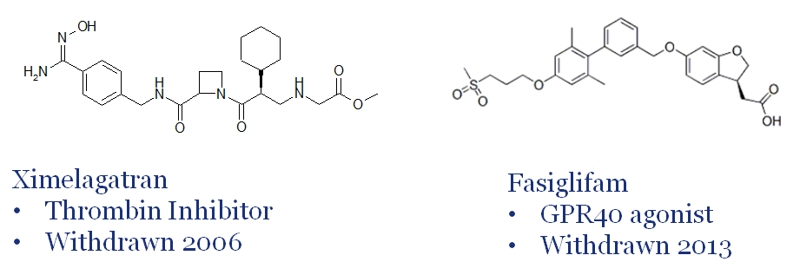
Recently Discontinued Drugs
Withdrawn owing to liver safety signals in Phase III:

Slide 4
Why No Preclinical Attrition?
Perhaps toxicological signals were not observed
Maybe signals were observed but…
their significance was not recognized
were considered manageable
Toxicological knowledge gaps

Slide 5
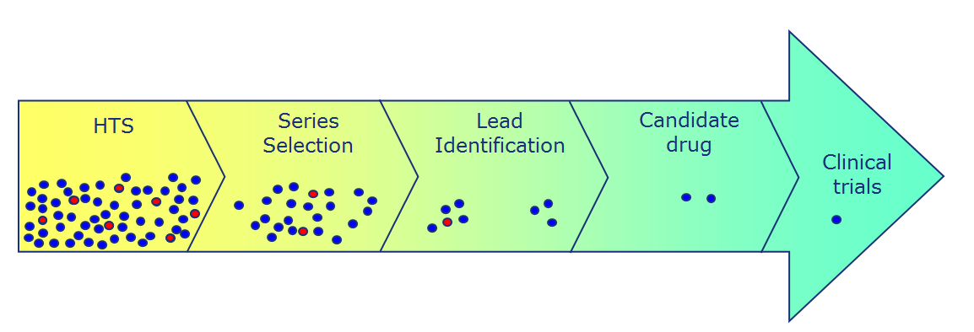
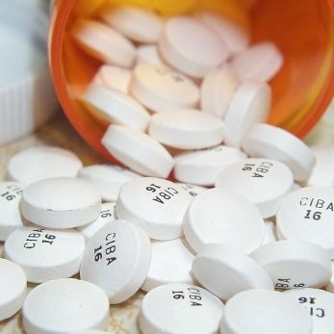
Exposing Toxicological Knowledge Gaps
Computational Toxicology
Predictive
in vitro/ in silico models
in vivo toxicology data
Investigative Toxicology

Slide 6
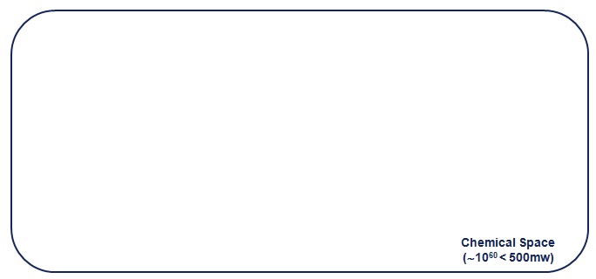

Exposing Toxicological Knowledge Gaps
Model
Applicability domain

Slide 7
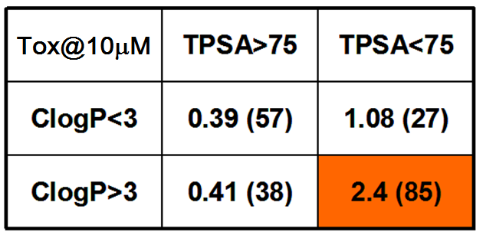
Example Pfizer Study: What Features Are Predictive of in vivo Toxicity
207 preclinical candidates investigated
Compounds were annotated against the observation of any in vivo toxicity findings at 10µM (total plasma exposure)
Odds of toxicity established for various physicochemical properties
TPSA and ClogP are calculated measures of lipophilicity
Hughes et al, Bioorg&Med Chem Lett, 2008,18, 4872–4875

Slide 8
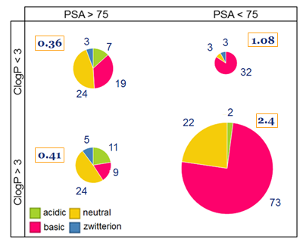

Thresholds Are Not Universally Applicable
pKa Class Distribution within dataset
Data from Hughes et al, Bioorg&Med Chem Lett, 2008,18, 4872–4875
Basic
e.g. aminergenic cpds
Training set is dominated by lipophilic basic drugs
Lipophilic basic drugs cause general toxicity, e.g. through lysosomal dysfunction, disruption membrane integrity and inhibition of ion channels and adrenergic GPCRs

Slide 9
Thresholds Are Not Universally Applicable
Neutral
Training set is dominated by lipophilic basic drugs
Lipophilic basic drugs cause general toxicity, e.g. through lysosomal dysfunction, disruption membrane integrity and inhibition of ion channels and adrenergic GPCRs

Slide 10
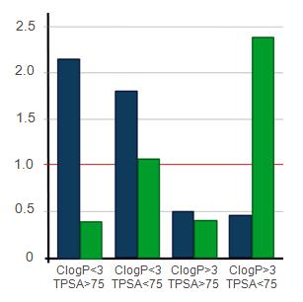

AZ Study: What Features Are Predictive of Preclinical Survival
Different profile to Pfizer study:
Toxicity Odds
D. Muthas et al, Med. Chem. Commun., 2013, 4, 1058

Slide 11
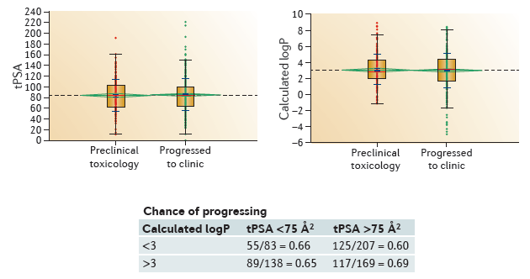
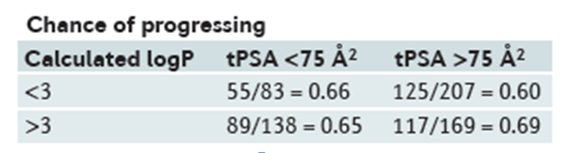
Results from A Pan-Pharma Study
Data from AZ, Eli Lilly, GSK and Pfizer
Focus on preclinical survival
Waring et al, Nature Reviews Drug Discovery 14, 475, 2015

Slide 12
Global Computational Analyses
Are useful in that they identify broad physico-chemical features associated with toxicity
Often related to exposure
These properties applicable across all chemical space
Unlikely to identify biological descriptors/mechanisms
Only applicable to certain subclasses of compounds
⇒ The utility of computational analyses is in the identification of toxicological knowledge gaps!

Slide 13
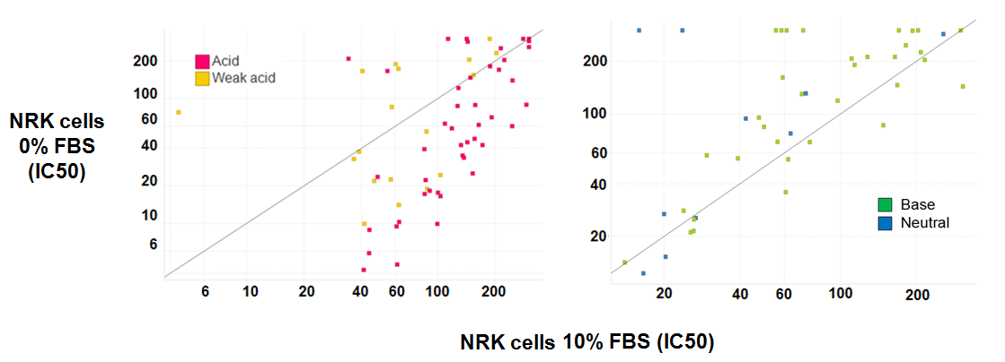
Understanding Liabilities in Acidic Compounds
Hypothesis: in vivo toxicity of acidic compounds may be masked in in vitro assays owing to protein binding to assay serum
Satoko Kakiuchi-Kiyota, The Toxicologist (SOT) 2015

Slide 14
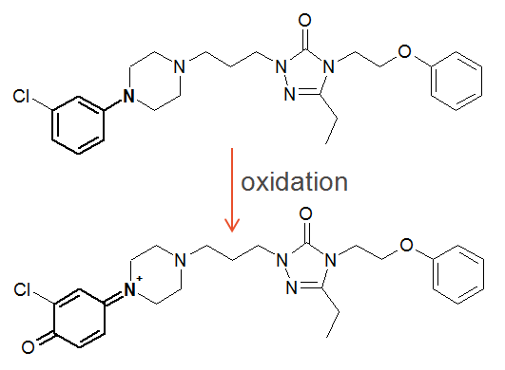
Toxicity is Multifactorial: Nefazodone
Potent 5-HT_{2A} receptor antagonist and antidepressant
Withdrawn 2003 for very rare, but severe, liver toxicity
Has multiple safety liabilities
Contains structural alert (aniline)¹
Metabolic liabilities²
Inhibitor bile-salt export pump³
Cytotoxic⁴
Mitochondrial dysfunction⁴
High dose: >200mg/day
Refs
1. Stepan et al., Chem. Res. Toxic., 2011, 24, 1345-1410.
2. Kalgutkar et al., Drug Metab. Disp., 2005, 33, 243-253 3. Kostrubsky et al, Toxicol. Sci., 2006, 90, 451-459
4. Dykens et al., Toxicol. Sci., 2008, 103, 335-345.

Slide 15
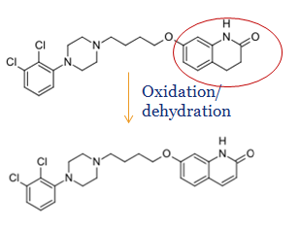
Toxicity is Multifactorial: Aripiprazole
Structurally similar, yet successfully marketed drug
No reports of acute hepatotoxicity
Has multiple in vitro liabilities
Contains structural alert (aniline) ¹
Metabolic liabilities²
Cytotoxic and lysosomotropic³
Low dose: 10-20 mg/day
⇒ Can we confidently class aripiprazole as non-hepatotoxic?
Refs
1. Stepan et al., Chem. Res. Toxic., 2011, 24, 1345-1410.
2. Bauman et al., Drug Metab. Disp., 2008, 36, 1016-1029. 3. Nadanaciva et al., Toxicol. in Vitro, 2011, 25, 715-723.

Slide 16
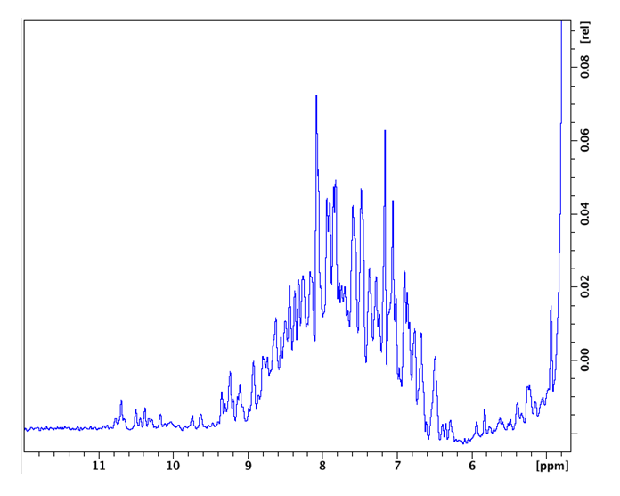
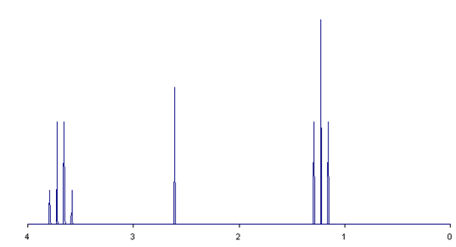
Toxicological Data is Very Noisy
….like this NMR spectra?!
Wiki: Loteralle
Wiki: T.vanschaik

Slide 17
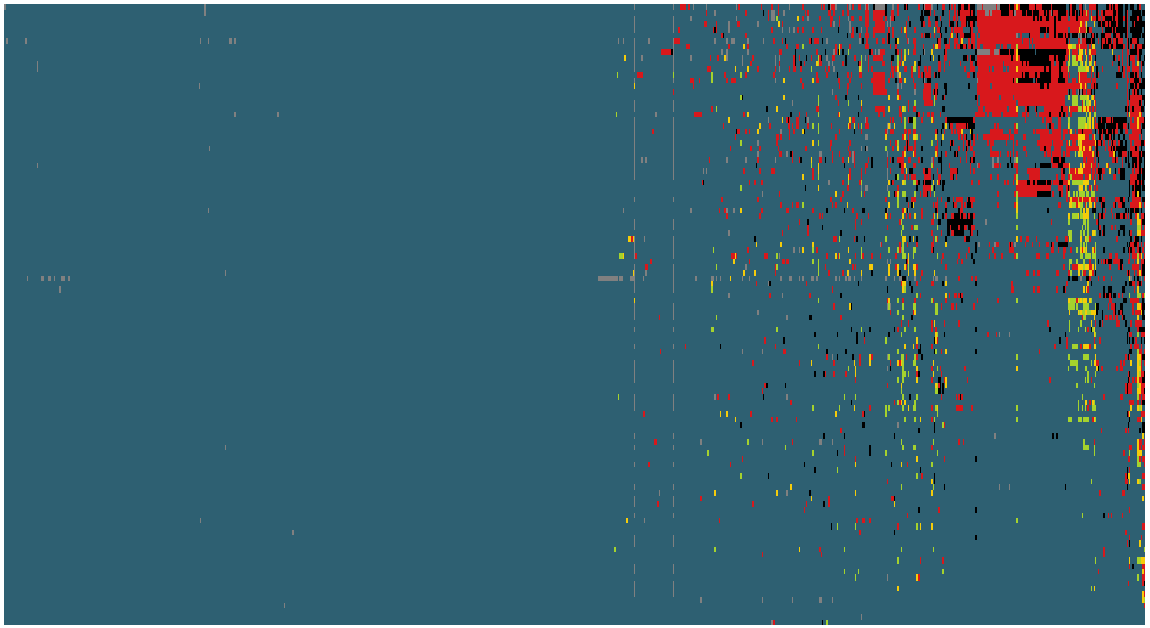
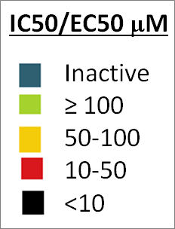
Tox21 Data
Heat map of 110 pharmaceutical compounds tested against 801 assays
Shah and Greene, Chem Res &Tox, 2014, 27, 86-98

Slide 18
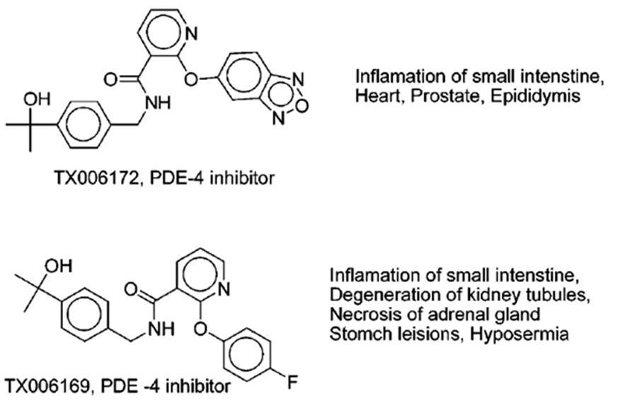
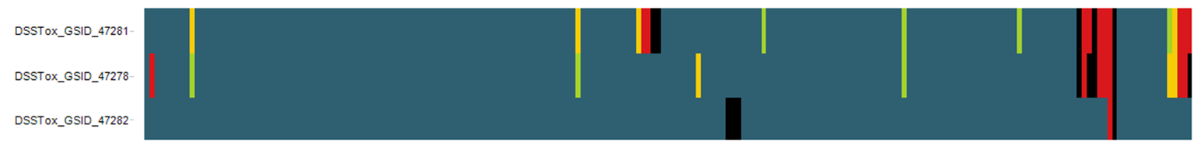
Analogues Can Drive Hypothesis Generation
Why different toxicity profile?
ADME?
Target Potency?
Off-target pharmacology?
(GSID_47281)
(GSID_47278)
CAR, RXRb, RORg
Shah and Greene, Chem Res &Tox, 2014, 27, 86-98

Slide 19
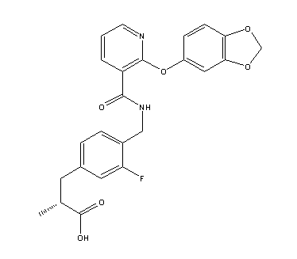
Analogues Can Drive Hypothesis Generation
Why different toxicity profile?
ADME?
Target Potency?
Off-target pharmacology?
(GSID_47281)
TX006173
(GSID_47282)
(GSID_47278)
CAR, RXRb, RORg
PDE10, PPARa
Shah and Greene, Chem Res &Tox, 2014, 27, 86-98

Slide 20
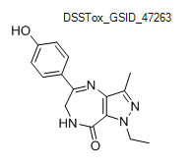
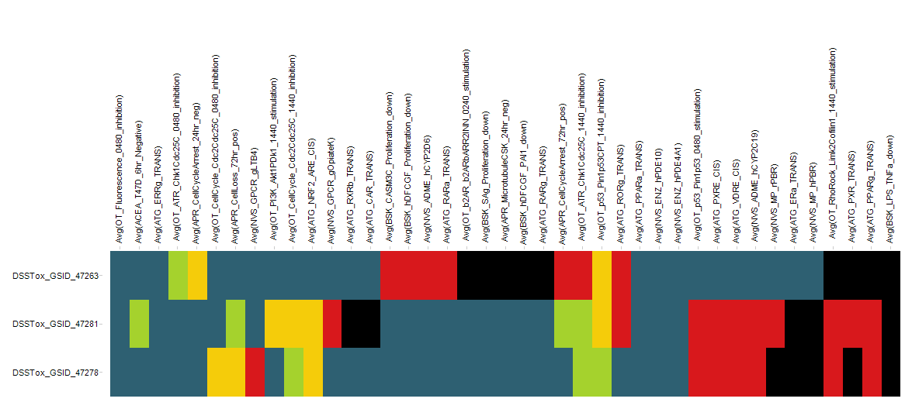
Different Chemotypes for the Same Target Have Different Profiles

Slide 21
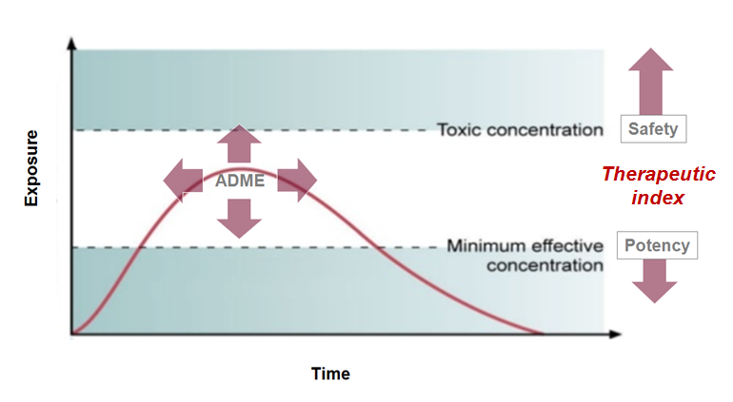
Reducing Drug Attrition

Slide 22
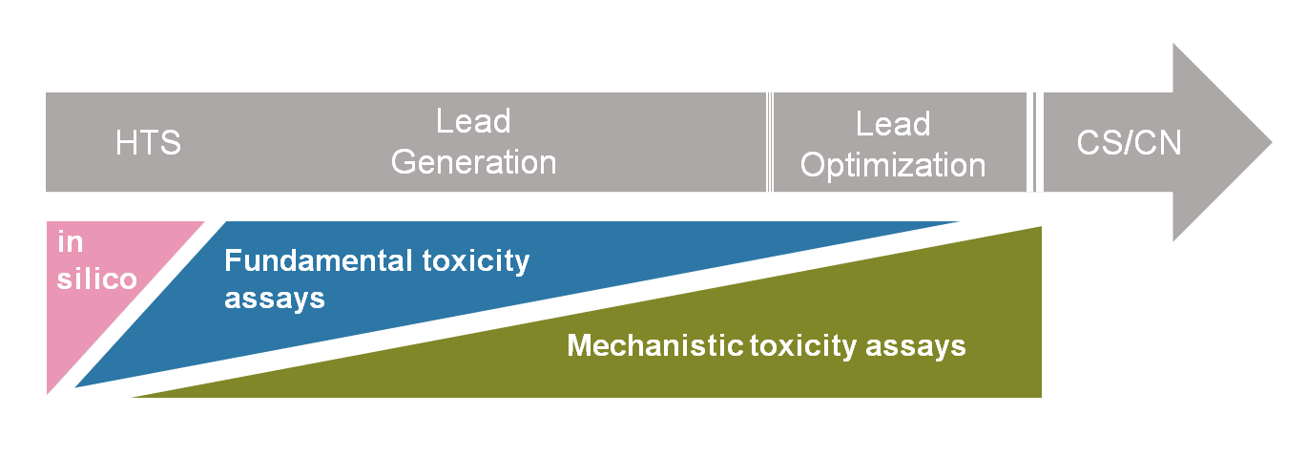
Developing Early Screening Paradigms
Cell health and disruption of homeostasis
Cytotoxicity
Mitochondrial Dysfunction
ROS/NOX induction
Promiscuity measure
Targets/phenotypic assays linked to toxicity
ion channels, hERG (cardiotox)
GPCRs (5HT2b agonism)
Specific cellular assays (iPS cells)
Cytokine storm
Disruption of Cellular Differentiation?

Slide 23
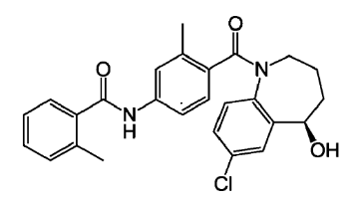
Recent Marketed Example
Tolvaptan
Competitive vasopressin receptor 2 antagonist by Otsuka Pharm
Approved by the FDA 2009
2012: FDA “Limits Duration and Usage Due To Possible Liver Injury Leading to Organ Transplant or Death”
Dose = 60mg/day
Cmax ≈ 1µM (total)

Slide 24
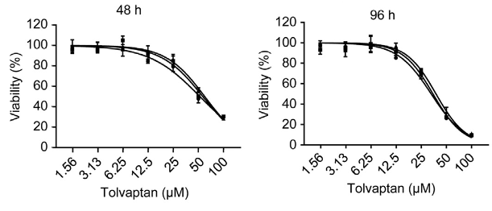
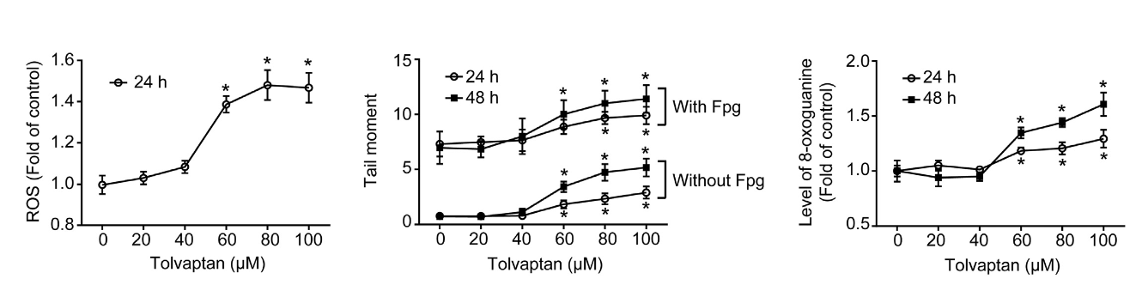
Tolvaptan Has HepG2 Cytotoxic Liabilities
Viability in Hepg2 cells:
Impact can be seen in other screening assays:
Why would a vasopressin receptor 2 antagonist cause cytotoxicity?
Likely due to inherent properties of the compound?
52.2 uM
33.0 uM
ROS Comet assay DNA oxidation
Wu et al. Biochemical Pharmacology 95 (2015) 324–336

Slide 25
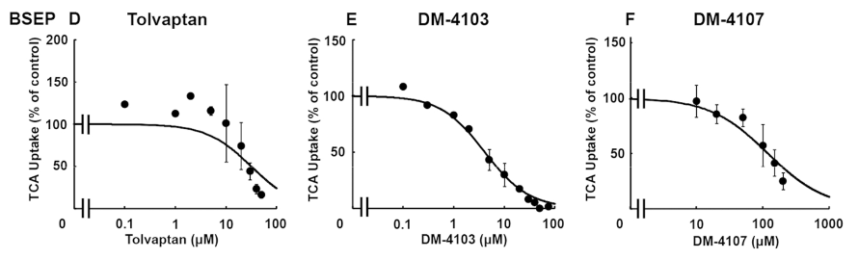
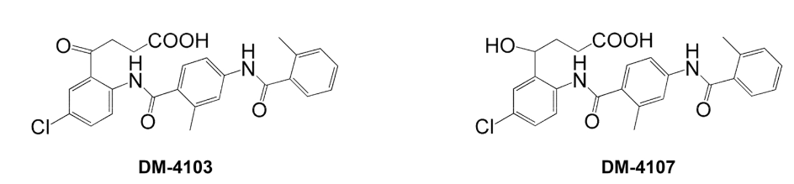
Tolvaptan May Disrupt Bile Acid Transport
Slizgi et al. Tox Sci Advance Access published October 26, 2015

Slide 26
Summary
Toxicology is exceptionally complex
Recognize limitations of global computational analyses
Improving toxicity prediction means deeper understanding of our tox data
Understand the applicability of assays and models
Identify knowledge gaps and drive investigative towards addressing them
Chemical/computational toxicology is inseparable from investigative toxicology

Slide 27
Acknowledgements
Yvonne Dragan
Nigel Greene
Jodi Maglich Goodwin
Shirley Louise-May
Satoko Kiyota
Thank you for listening!

